Slide 1
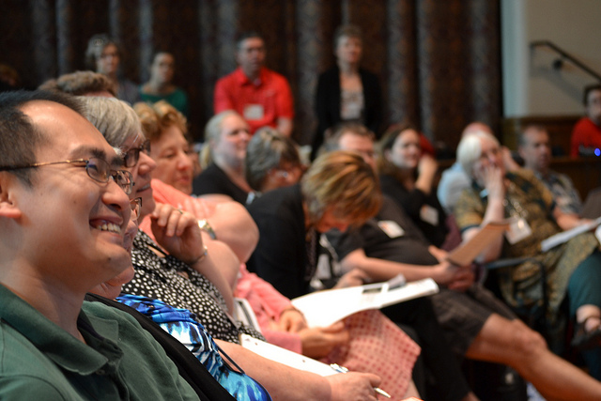
Review of Homiletics 1
Dr. Rick Griffith • Jordan Evangelical Theological Seminary • BibleStudyDownloads.org

Slide 2
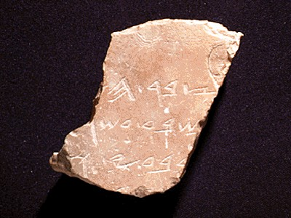
What Makes a Sermon Expository?
1
"Expository preaching explains a passage in such a way to lead the congregation to a true and practical application of that passage"
Definitions
Walter Liefeld, NT Exposition, 6
Notes:
04.03

Slide 3
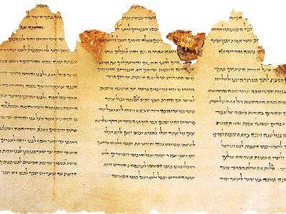
A More Detailed Definition…
1
“Expository preaching is the proclamation (or communication) of a biblical concept, derived from and transmitted through a historical, grammatical, literary study of a passage in its context, which the Holy Spirit has first made vital in the personality of the preacher, and then through him applies to the experience of the congregation” (Robinson, 20, adapted by him in a preaching seminar)
Notes:
04.04

Slide 4
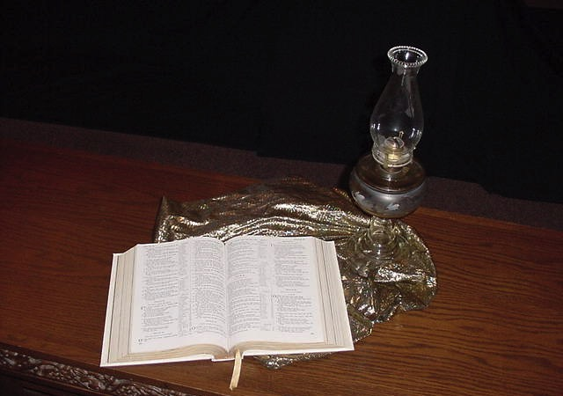
Why is Expository Preaching Important?
2
Notes:
04.11 new format

Slide 5
Exposition is based on an inerrant text that shows God's will
2
In our personal devotional lives
In our families
In our work
In our Bible studies (including this one)
Notes:
04.12
The more we preach from Scripture, the less false teaching we will have.
We have only ONE inerrant book! Why preach other things?

Slide 6
The Preparing Expository Sermons Process
27-28, 251
Based on Ramesh Richard's text, Preparing Expository Sermons
TEXT
SERMON
5 Desired Listener Response
Brain
4 The Three
Developmental
Questions
Purpose Bridge
3.2 Exegetical Idea
CPT
Heart
CPS
6 Homiletical Idea
7 Homiletical
Outline
8 Clarity
9 Intro/Concl
3.1 Exegetical
Outline
Structure
Skeleton
Structure
2 Analyze Text
Study
Flesh
Preach
10 MSS &
Preach
1 Choose Text
White text shows 10 steps adapted from Haddon Robinson, Biblical Preaching (notes, 105)
Notes:
29.01

Slide 7
Exegetical Outlining
31
How to outline based on the text
Notes:
08.01

Slide 8
Forming the Big Idea (CPS)
29
Subject
(Theme)
Complement
(Thrust)
The Question
The Answer
The reason people should praise God…
The test of a person's character…
Notes:
07.06

Slide 9
What is the Z1+X+Z2+Y Form?
33
Subject (Z1+X)
Complement (Z2+Y)
“The” + qualifiers
“is” + matching qualifier
Theme
Sub-theme
WARNING:
Writing statements in this four-point form forces you to be crystal clear on what you think a section of Scripture means!
You could be clear but wrong though--so still use good hermeneutics!
Notes:
09.08 Start the sentence with the word "the."

Slide 10
Example 1 of Z1+X+Z2+Y Form
33
Notes:
09.09

Slide 11
Example 2 of Z1+X+Z2+Y Form
33
Notes:
09.10

Slide 12
Example 3 of Z1+X+Z2+Y Form
33
Notes:
09.11

Slide 13
Checking Z1+X+Z2+Y Form
33
Notes:
09.12

Slide 14
Checking Z1+X+Z2+Y Form
33
Notes:
09.13

Slide 15
Homiletical Questions & Qualifiers
34
Who
Notes:
09.14

Slide 16
Homiletical Questions & Qualifiers
34
What
Notes:
09.15

Slide 17
Homiletical Questions & Qualifiers
34
Where
When
Why
Under what condition
How
Notes:
09.16

Slide 18
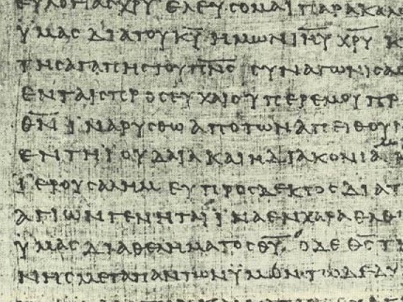
How do you know which qualifier to use?
34
Look for key connectives in the text (e.g., “and,” “but,” “so that,” “because,” etc.).
Match them with the right Z₁ and Z₂.
Use them in a EI that translates figures of speech.
“Put on the full armor of God so that you can take your stand against the devil's schemes.”
“The purpose for consistent spiritual disciplines is so that we can defend ourselves against Satan's attacks.”
Notes:
09.17

Slide 19
The Preparing Expository Sermons Process
27-28, 251
Based on Ramesh Richard's text, Preparing Expository Sermons
TEXT
SERMON
5 Desired Listener Response
Brain
4 The Three
Developmental
Questions
Purpose Bridge
3.2 Exegetical Idea
CPT
Heart
CPS
6 Homiletical Idea
7 Homiletical
Outline
8 Clarity
9 Intro/Concl
3.1 Exegetical
Outline
Structure
Skeleton
Structure
2 Analyze Text
Study
Flesh
Preach
10 MSS &
Preach
1 Choose Text
White text shows 10 steps adapted from Haddon Robinson, Biblical Preaching (notes, 105)
Notes:
11.04

Slide 20
Definitions Review
40
Step 3: The exegetical idea (CPT) summarizes the text's message to the biblical audience
Step 4: The sermon's purpose (desired listener response) is the behavior change you want in the hearers as a result of your preaching the homiletical idea
Step 5: The homiletical idea (CPS) summarizes the sermon for the modern audience
Notes:
11.5; 23.20; 23.48

Slide 21
Sermon Purpose Examples
40
“The listeners will…”
Know
Feel
Do
• “thank and appreciate their mothers for the ministry they have had in their lives” (p. 86)
• “gladly do humble tasks for others” (p. 148)
^{Desired Listener Response}
Notes:
11.06

Slide 22
Sermon Purpose Examples
40
“The listeners will…”
Know
Feel
Do
• “see God's priority in missions and commit themselves to be best used in the fulfillment of the Great Commission” (p. 156)
^{Desired Listener Response}
Notes:
11.07

Slide 23
Sermon Purpose Examples
40
“The listeners will…”
Know
Feel
Do
• “rid themselves of ungodly influences which wreck their own spiritual lives and eventually that of the church” (p. 170)
^{Desired Listener Response}
Notes:
11.08

Slide 24
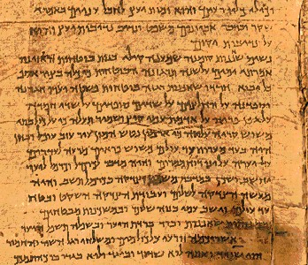
Contrasting the Ideas
40
Issue
Passage
Sermon
Order
First
Second
Place
Study
Pulpit
Steps
Obs/Inter
Prin/App
Concern
Accuracy
Relevance
Notes:
11.10

Slide 25
Contrasting the Ideas
40
Issue
Passage
Sermon
Form
Z₁-X-Z₂-Y
Slogan
Length
2-3 lines
1-2 lines
Outline
Sequential
Logical
To be
Read
Heard
Notes:
11.11

Slide 26
Contrasting the Ideas
40
Issue
Passage
Sermon
Audience
Time bound
Timely
Tense
Past
Present
Mood
Indicative
Imperative
Person
3rd
1st or 2nd
Notes:
11.12

Slide 27
Contrasting the Ideas
40
Issue
Passage
Sermon
Question
God to them
God to us
Needs
Original
Modern
Focus
Textual
Cultural
Purpose
Summarize
Communicate
Notes:
11.13

Slide 28
Comparing the Ideas
40
Write both the CPT & CPS:
• in the active voice
• in full sentences
• with correlating Z₁s & interrogatives
• so they include the whole passage
Notes:
11.14

Slide 29
How to Restore Relationships
Matthew 18:15-20 Exegetical Outline
10 December 2006
6 March 2011
Notes:
09.31

Slide 30
Matthew 18:15-20
If your brother sins against you, go and show him his fault, just between the two of you. If he listens to you, you have won your brother over. ¹⁶But if he will not listen, take one or two others along, so that 'every matter may be established by the testimony of two or three witnesses.' ¹⁷If he refuses to listen to them, tell it to the church; and if he refuses to listen even to the church, treat him as you would a pagan or a tax collector. ¹⁸I tell you the truth, whatever you bind on earth will be bound in heaven, and whatever you loose on earth will be loosed in heaven. ¹⁹Again, I tell you that if two of you on earth agree about anything you ask for, it will be done for you by my Father in heaven. ²⁰For where two or three come together in my name, there am I with them.
How to Restore 15-17
Why to Restore 18-20
Notes:
08.20 & 09.32 two main teachings on restoring Christians in sin

Slide 31
I. (15-17) The manner in which the church should correctly restore a sinning Christian is by keeping the matter as private as possible.
(15) A private sin should be dealt with only between those directly involved so as to make restoration of the offender easier.
(16) Unrepentant sin after a private confrontation should be exposed only to one or two more persons in order to facilitate restoring the sinner.
(17a) Unrepentant sin after a small group attempt at restoration should be brought before the entire church body as a deterrent to continued sin.
(17b) Unrepentant sin after exposure to the church should result in requiring each church member to relate to the sinner as an unbeliever (this includes removal from membership).
Notes:
09.33

Slide 32
II. (18-20) The reason the church can restore or excommunicate errant believers is because it acts as an extension of the authority of God Himself.
(18-19) Churches that prayerfully restore or excommunicate sinful believers act in the place of the Father.
(18) The church must announce guilt or innocence based upon what God has already determined.
(19) Church leaders who prayerfully make a judgment can have confidence that they have acted according to God's will.
(20) Churches that restore or excommunicate sinful believers act in the presence of Jesus Christ.
Notes:
09.34

Slide 33
Exegetical Idea: The reason the church should restore a sinning Christian correctly is because this restoration is carried out as an extension of God's authority.
(15-17) The manner in which the church should correctly restore a sinning Christian is by keeping the matter as private as possible.
(18-20) The reason the church can restore or excommunicate errant believers is because it acts as an extension of the authority of God Himself.
Notes:
09.35

Slide 34
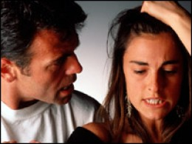
How do we restore sinning Christians properly?
Our First Question Today... (introduces MP I for vv. 15-17)
Notes:
12.18 Fill in your bulletin outline

Slide 35
The Point of Verses 15-17
I. Keep the matter as private as possible (15-17).
Notes:
12.19 abbreviated

Slide 36
Our Goal:
Our Goal:
Restoration!
Notes:
11.27; 23.36

Slide 37
God's 4-step restoring process…
4
3
2
1
…reveals the issue to more people each step
Notes:
11.28

Slide 38
Transition after MPI finished: Our 2nd question is answered in vv. 18-20: Why do we restore sinning Christians properly?
Notes:
11.29

Slide 39
The Point of Verses 18-20
II. Our church acts as an extension of the authority of God Himself!
Notes:
11.30

Slide 40
A Better Translation…
NAU is a Better Translation…
NIV “I tell you the truth, whatever you bind on earth will be {or have been} bound in heaven, and whatever you loose on earth will be {or have been} loosed in heaven.”
NAU “Truly I say to you, whatever you bind on earth shall have been bound in heaven; and whatever you loose on earth shall have been loosed in heaven.”
Notes:
08.39

Slide 41
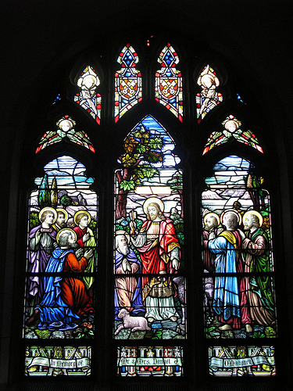
Matthew 18:19
"Again, I tell you that if two of you on earth agree about anything you ask for, it will be done for you by my Father in heaven" (NIV).
Notes:
08.40

Slide 42
Psalm 82:1, 6 (to Israel's rulers/gods)
"I said, 'You are "gods"; you are all sons of the Most High… but you will die like men…"
Notes:
08.41

Slide 43
Why discipline? When we seek to restore someone…
We act in the place of the Father (18-19)
We act in the presence & authority of Christ (20)
Notes:
08.41

Slide 44
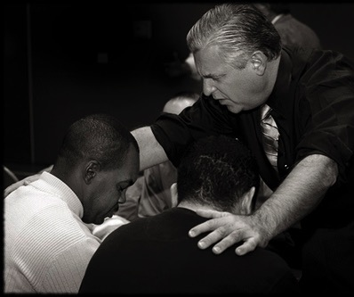
Matthew 18:20
"For where two or three come together in my name, there I am with them" (NIV).
Notes:
08.43

Slide 45
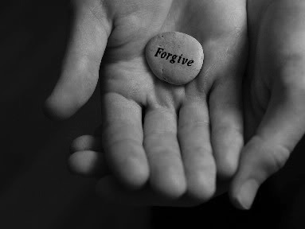
Main Idea:
Exegetical Idea: The reason the church should restore a sinning Christian correctly is because this restoration is carried out as an extension of God's authority.
We restore sinning members properly since we act on God's behalf
Notes:
08.43 and more

Slide 46
How I grade Col. 4:6 EO (Assign. #4)
22
Make sure you follow each item on the p. 22 checklist
1. Have you written your questions & answers of the text and the text itself at the top (if preaching 1-2 verses)?
2. Are the Exegetical Idea (EI) and Main Points (MPs) all written in proper Z1+X+Z2+Y form?
20. Is the focus the recipients in the past (not present) tense (Write “The way the Colossians should…” not “We should…”) and in active (not passive) voice?
Is the EI and outline exegesis true to the author’s intent? (AI = evaluate Authorial Intent)?
19. Do SPs (or MPs) avoid ideas not in the text (e.g., from cross-references)? (“NP” = not in passage)?
22. Does each point have a coordinating point (“I” has “II”, “A” has “B”; p. 61 [II.A.1.] & p. 55)?
2. Are the Exegetical Idea (EI) and Main Points (MPs) all written in proper Z1+X+Z2+Y form?
27. Does each sentence in the outline include its correct verse, verses, or verse portion (1a, 1b, 1c, etc.)?
Does at least one Z1 in the MPs match that of the EI?
16. Do statements translate figures of speech rather than use the text’s words? (“TF”)
Notes:
12.02

Slide 47
Developmental Questions Summary
39
Notes:
10.20

Slide 48
Definitions Review
40
Step 3: The exegetical idea (CPT) summarizes the text's message to the biblical audience
Step 4: The sermon's purpose (desired listener response) is the behavior change you want in the hearers as a result of your preaching the homiletical idea
Step 5: The homiletical idea (CPS) summarizes the sermon for the modern audience
Notes:
11.5; 23.20; 23.48

Slide 49
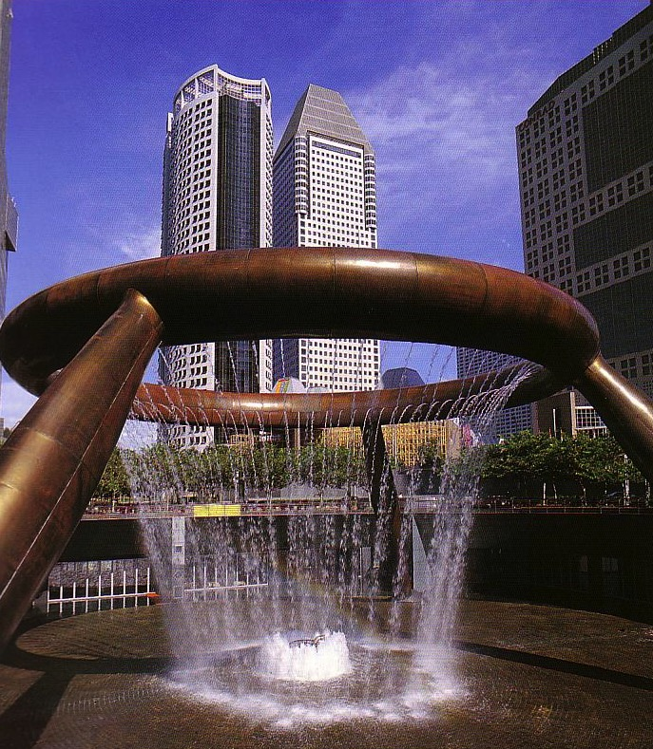
Sermon Structure
Buildings need structure.
Sermons do too!
Dr Rick Griffith, Singapore Bible College
www.biblestudydownloads.com
Notes:
12.01

Slide 50
Types of Sermon Structure
47
Inductive- Deductive
Deductive
Inductive
Introduction
CPS
Theme
Theme
I
I
I
CPS
Body
II
II
II
III
III
III
Conclusion
Restate CPS
CPS
Restate CPS
Advantages:
Clear
Interesting
Variety
Notes:
12.08

Slide 51
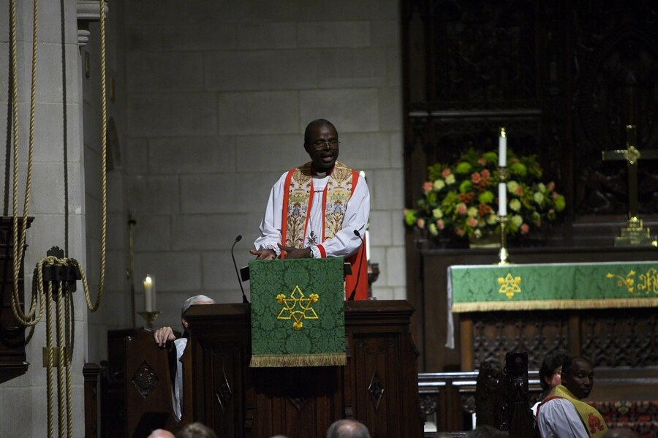
Introductions
GRIP PAT
STAIN
G R I P P A T
S T A I N
Conclusions
Notes:
17.29 Do you remember the acronym for elements of introductions?
Yes, GRIP PAT
What is the acronym for five elements of conclusions?
STAIN

Slide 52
Introductions
74
GRIP PAT
G
R
I
P
P
A
T
Get Attention
Raise Need
Introduce S/MI/MPI
Provide Background
Preview MPs
Announce Text
Transition to MPI
Notes:
17.36

Slide 53
Conclusions Review
74
STAIN
S
T
A
I
N
State your MI (or restate it)
Tell the Main Points
Apply or exhort obedience
Include Variety
Never announce a conclusion
Conclusions
Notes:
17.37

Slide 54
Introductions
74
GRIP PAT
G
R
I
P
P
A
T
Get Attention
Raise Need
Introduce S/MI/MPI
Provide Background
Preview MPs
Announce Text
Transition to MPI
Notes:
17.36

Slide 55
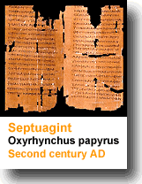
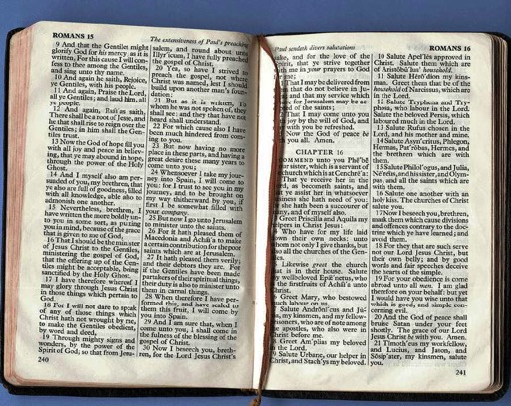
Share only relevant background
Give background before text
Need
Background
Text
Notes:
17.20

Slide 56
Introductions
74
Contact Points
GRIP PAT
Secular
Get Attention on the Subject
Raise Need
Introduce the Subject, MI, or MPI
Provide Background
Personal
Structural
Biblical
Contact points from Hostetler, Introducing the Sermon
Notes:
17.21

Slide 57
Introductions
74
GRIP PAT
Get Attention on the Subject
Raise Need
Introduce the Subject, MI, or MPI
Provide Background
Preview Outline
Notes:
17.22

Slide 58
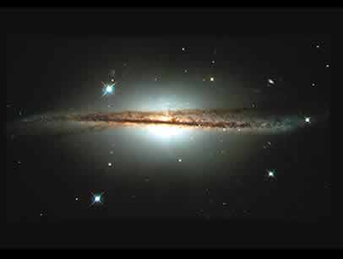
Previewing Your Message
What it does
Reviews your subject
Gives the number of MPs (but not the whole points themselves)
Examples
Today's passage will show us…
2 ways to reverence God (pp. 51, 82)
3 reasons we should get dirty for others (p. 148)
3 principles on finding a mate (p. 157e)
what God thinks of missions and what we should do in response (p. 156)
Notes:
17.23

Slide 59
The Body of the Message
76
Full sentence Main Points
Transitions
Illustrations
Movement
Restate subject
Notes:
15.32

Slide 60
Comparing the Ideas
40
Write both the CPT & CPS:
• in the active voice
• in full sentences
• with correlating Z₁s & interrogatives
• so they include the whole passage
Notes:
11.14

Slide 61
Conclusions Review
74
STAIN
S
T
A
I
N
State your MI (or restate it)
Tell the Main Points
Apply or exhort obedience
Include Variety
Never announce a conclusion
Conclusions
Notes:
17.37

Slide 62
An Old Adage on Clarity
75
Tell
Them
Tell them what you are going to tell them
Then tell them what you told them
Notes:
17.31

Slide 63
Types of Transitions
68
Incomplete Sentence
Subject: How can we know how to speak to non-Christians (Col. 4:6c)?
Preview: We will see two ways to speak to non-Christians.
(The first way to speak to non-Christians is to…)
I. Speak gracious words (6a)
(The second way to speak to non-Christians is to…)
II. Speak wise words (6b)
Notes:
17.23

Slide 64
How to Preach Clearly
Some sermons are as clear as ancient Hebrew!
Notes:
15.01

Slide 65
Clarity in Your Introduction
67
1. To emphasize each key sentence either:
a. Repeat it (use same words).
b. Restate it (use different words).
2. Clearly lead toward one of these three:
a. Main Idea
b. Subject
c. MP I
3. Share relevant background before text.
Notes:
15.10

Slide 66
Clarity in the Body
68
Repetition
Restatement
Transitions
Key Words
Deductive Development
Notes:
15.26

Slide 67
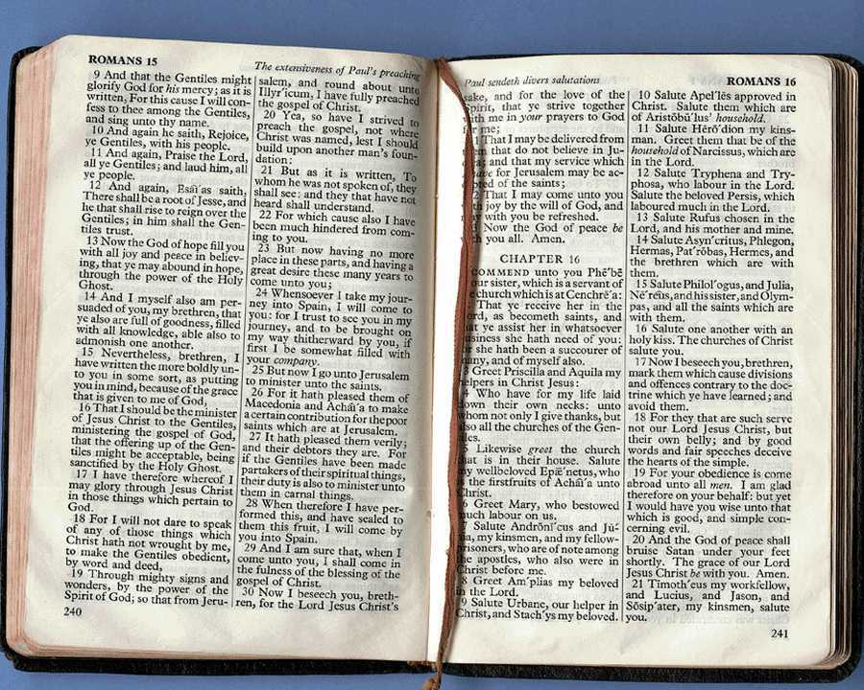
Clarity in the Conclusion
68
State the Main Idea (MI)
Repeat the Main Points (MPs)
Drive it home with a clear story
Notes:
15.30

Slide 68
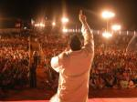
Use Movement
68
!ytiralc rof sdrawkcab erutseG
Gesture backwards for clarity!
"He is the Alpha and Omega, the A and the Z, the beginning and end."
Notes:
15.31

Slide 69
Black

Slide 70
The Preparing Expository Sermons Process
27-28, 251
Pop Quiz
On a piece of paper, fill in the 13 blanks below…
TEXT
SERMON
Brain
Purpose Bridge
CPT
Heart
CPS
Structure
Skeleton
Structure
Study
Flesh
Preach
Notes:
11.02

Slide 71
The Preparing Expository Sermons Process
27-28, 251
Based on Ramesh Richard's text, Preparing Expository Sermons
TEXT
SERMON
5 Desired Listener Response
Brain
4 The Three
Developmental
Questions
Purpose Bridge
3.2 Exegetical Idea
CPT
Heart
CPS
6 Homiletical Idea
7 Homiletical
Outline
8 Clarity
9 Intro/Concl
3.1 Exegetical
Outline
Structure
Skeleton
Structure
2 Analyze Text
Study
Flesh
Preach
10 MSS &
Preach
1 Choose Text
White text shows 10 steps adapted from Haddon Robinson, Biblical Preaching (notes, 105)
Notes:
11.04

Slide 72
The Preparing Expository Sermons Process
27-28, 251
Based on Ramesh Richard's text, Preparing Expository Sermons
TEXT
SERMON
5 Desired Listener Response
Brain
4 The Three
Developmental
Questions
Purpose Bridge
3.2 Exegetical Idea
CPT
Heart
CPS
6 Homiletical Idea
7 Homiletical
Outline
8 Clarity
9 Intro/Concl
3.1 Exegetical
Outline
Structure
Skeleton
Structure
2 Analyze Text
Study
Flesh
Preach
10 MSS &
Preach
1 Choose Text
White text shows 10 steps adapted from Haddon Robinson, Biblical Preaching (notes, 105)
Notes:
11.04 without red circle

Slide 73
The Preparing Expository Sermons Process
27-28, 251
Based on Ramesh Richard's text, Preparing Expository Sermons
TEXT
SERMON
Brain
Purpose Bridge
CPT
Heart
CPS
Structure
Skeleton
Structure
Study
Flesh
Preach
Notes:
11.04 without white text

Slide 74
The Topical Exposition Process
155a
Topic
TEXTS
SERMON
Brain
Purpose Bridge
CPT
Heart
CPS
CPTs
Skeleton
Structure
Structures
Study
Flesh
Preach
Notes:
24.11

Slide 75
Preaching (Homiletics) link at BibleStudyDownloads.org
Get this presentation for free!
Notes:
Preaching (pr)
Homiletics

